Slide 1

Project Work - II
Project Name: BCPL
Presented By:
Shantanu Malviya (EN16CS301242)
Shruti Goyal (EN16CS301249)
Sonal Balwani (EN16CS301266)
Guided By:
Prof. (Dr.) Ruchi Patel
Mr. Nischay Goyal (BCPL)

Slide 2
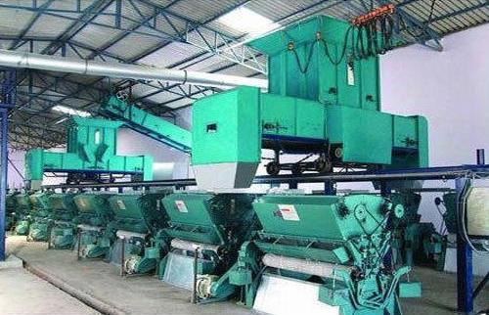
Workplace
Name: Bajrang Cotton Private Limited
Address: Jaimalpura, Maheshwar Road, Barwaha (M.P.)
Company CIN: U17121MP2011PTC025896
Directors: Mr. Sanjay Goyal, Mr. Dilip Goyal
Email: bcplbarwaha@gmail.com
Contact: 07280-290175

Slide 3
About the Company
Bajrang Cotton Private Limited is an approved Ginning Pressing Company founded in 2011. The Company is engaged in manufacturing and export of best quality cotton bales, cotton seeds, cotton seed oil and cotton seed cakes in all principal world market . The company is professionally managed company having large network and infrastructure, It is equipped with state-of-art infrastructure backed by large and fully automatic plant for cotton to cotton bales. Company has its roots since, the beginning of Cotton Ginning & Pressing in this region.
They lead the market in their region and have a large workforce. They sell their goods to the spinning industries and process the CCI cotton as they get tenders. All the administrative work is carried out there manually by their administrative team.

Slide 4
Problem Statement
All the administrative work is processed manually that is very difficult for a large scale industry
There is no automated system available to record the details of customers and client organizations
They work for multiple markets so it is difficult to manage the data manually for all of them
There are chances of data loss, data redundancy and data inconsistency
There may be security breach and theft practices for a large scale industry
Amount of production, sales, stock available, profit and loss details need to be automated

Slide 5
Solution Statement
Automated System will reduce staff dependency
The data will be recorded in a specific format which will provide consistency to the systems and possibilities for comparison with past records
Software will help to handle data for multiple markets easily at one place and the same data will be available to every team reducing the chance of data inconsistency
Customer information, accounts and other confidential data will be more secured with a automated system
It will be easy to manage all the dues and payments
The system can be accessed remotely through mobile too

Slide 6
About the Project
BCPL
It is a supportive automated system for the company to create invoices, manage clients, accounts etc.
It can create invoice PDFs and mail the same to the client according to due date
It can display the paid and unpaid dues
It will help to store multiple details for a client and support for their management
It provides multiple modules for Admin and Agent Login
It helps to keep record of the stocks and manage the entire inventory

Slide 7
Technology Used
Front End
Blade Templates
Gentella Theme Used
HTML, CSS, Bootstrap
Back End
Laravel Version 5.6
MySQL version 5.6
Visual Studio Code

Slide 8
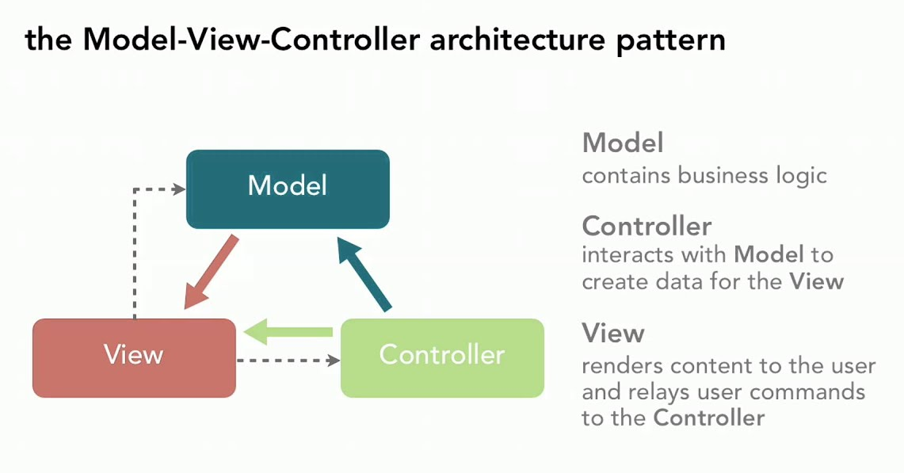
Laravel
Laravel is an open-source PHP framework, which is robust and easy to understand. It follows a model-view-controller design pattern. Laravel reuses the existing components of different frameworks which helps in creating an application. The application thus designed is more structured and pragmatic.

Slide 9
Why Laravel ?
1.MVC Support and Object-Oriented Approach
2.Built-In Authentication and Authorization
3.Packaging System
4.Multiple file System
5.Artisan Console
6.Eloquent ORM
7.Templating engine
8.Testing

Slide 10
Individual roles

Slide 11
Model
The model manages fundamental behaviors and data of the application. It can respond to requests for information, respond to instructions to change the state of its information, and even notify observers in event-driven systems when information changes. This could be a database or storage systems. In short, it is the data and data-management of the application.

Slide 12
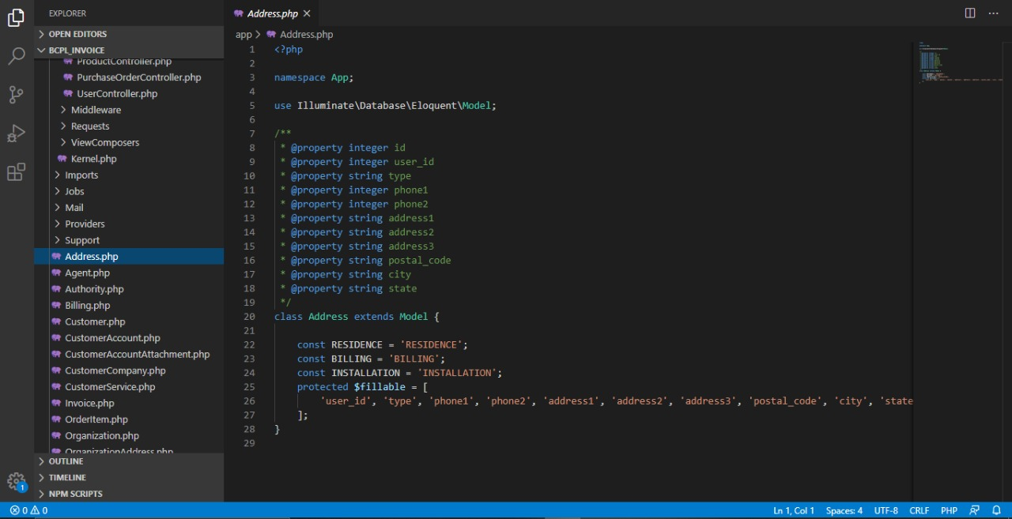
Screenshot of model

Slide 13
View
The view effectively provides the user interface element of the application. It’ll render data from the model into a form that is suitable for the user interface. The view presents the model’s data to the user. The view knows how to access the model’s data, but it does not know what this data means or what the user can do to manipulate it.

Slide 14
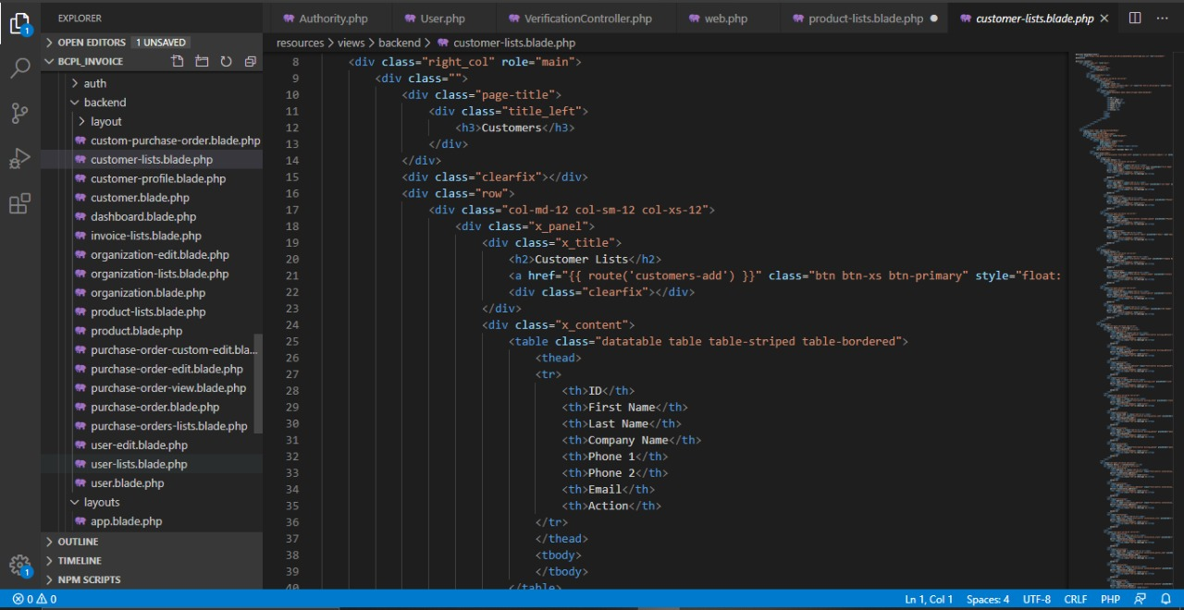
Screenshot of view

Slide 15
Controller
The Controller exists between the view and the model. It listens to events triggered by the view (or another external source) and executes the appropriate reaction to these events. In most cases, the reaction is to call a method on the model. Since the view and the model are connected through a notification mechanism, the result of this action is then automatically reflected in the view.

Slide 16
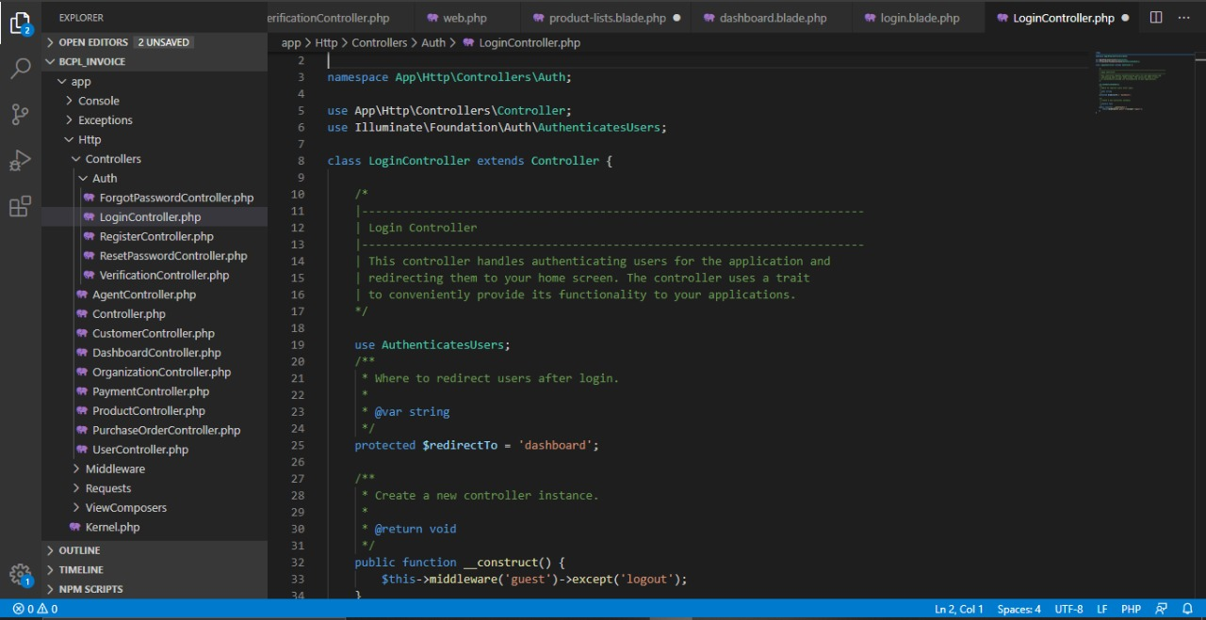
Screenshot of controller

Slide 17
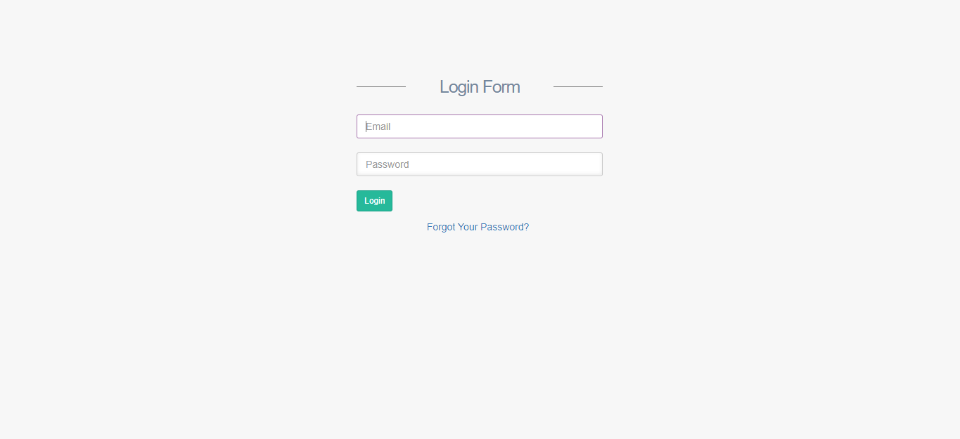
Screenshots of Project
Login Page

Slide 18
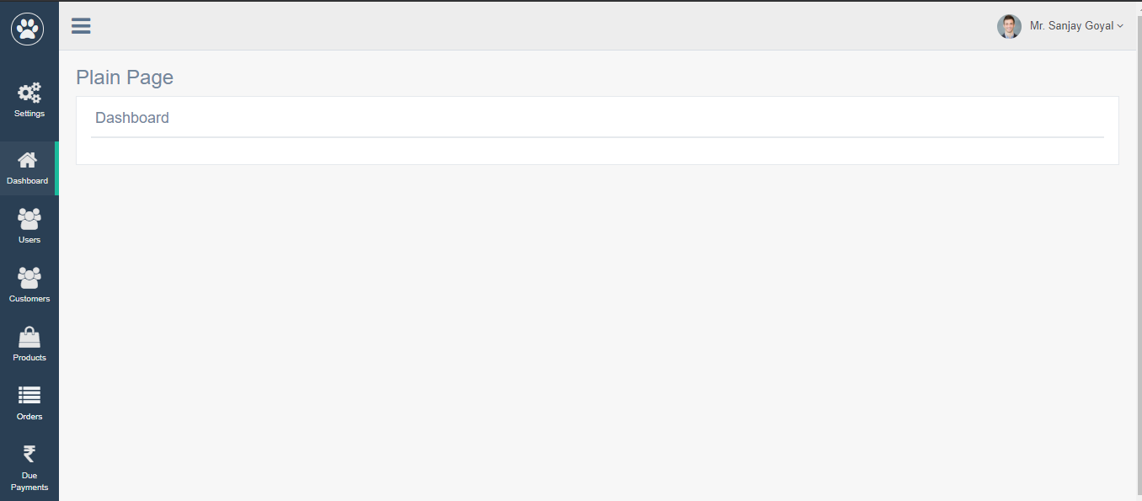
Dashboard

Slide 19
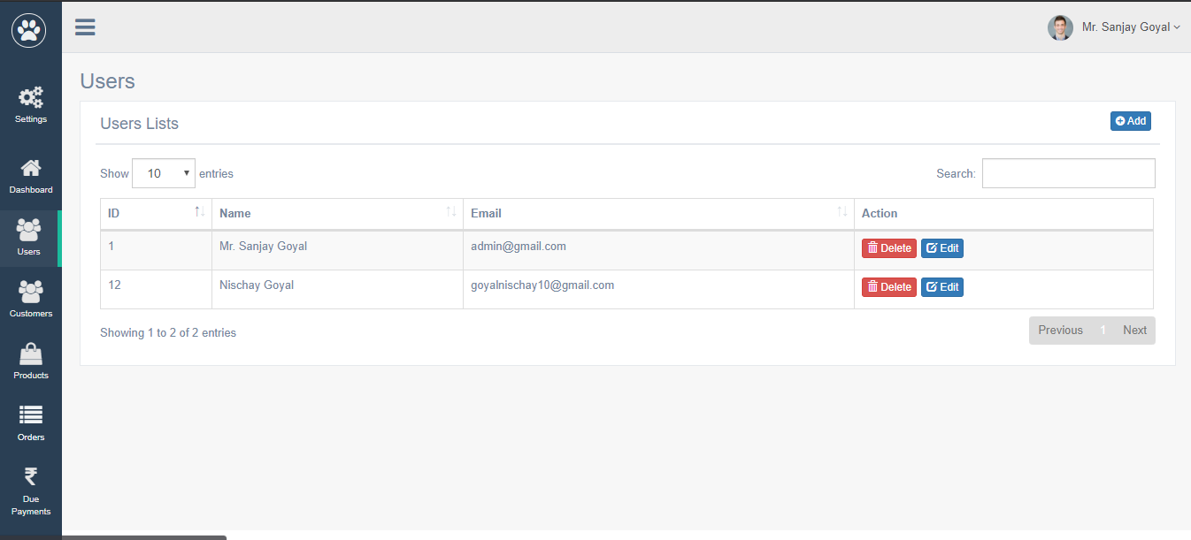
Users Page

Slide 20
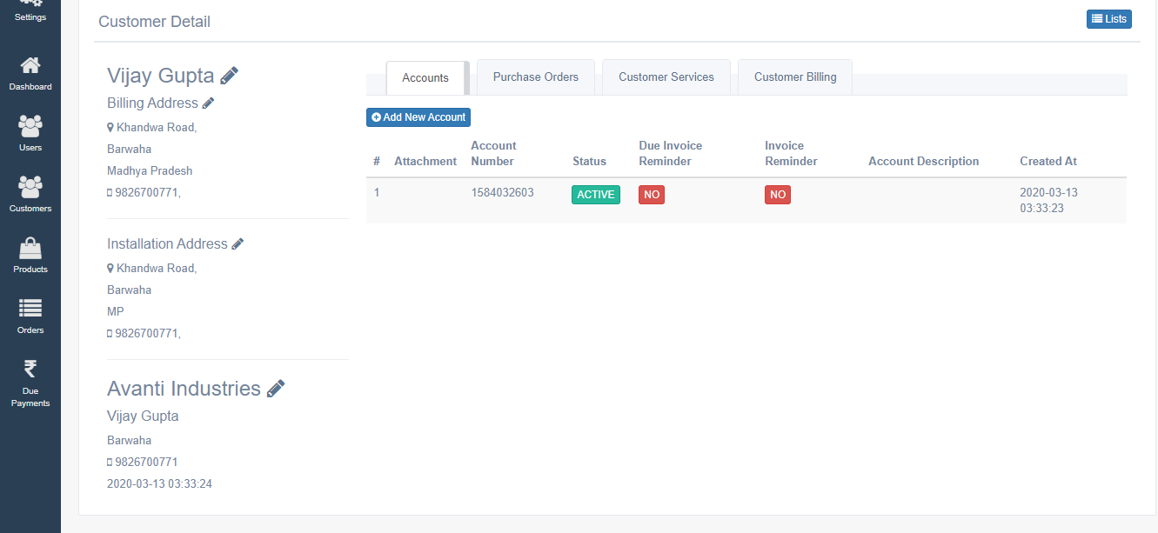
Customer Details

Slide 21
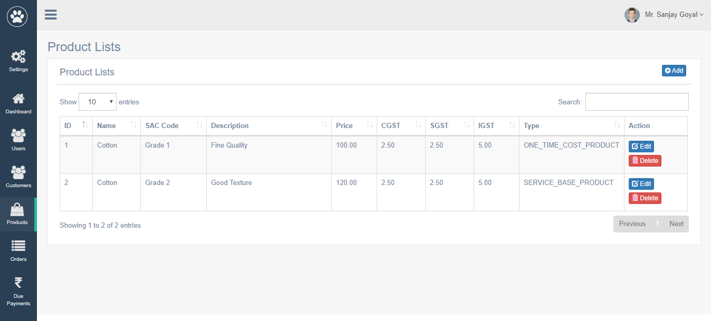
Product Lists

Slide 22
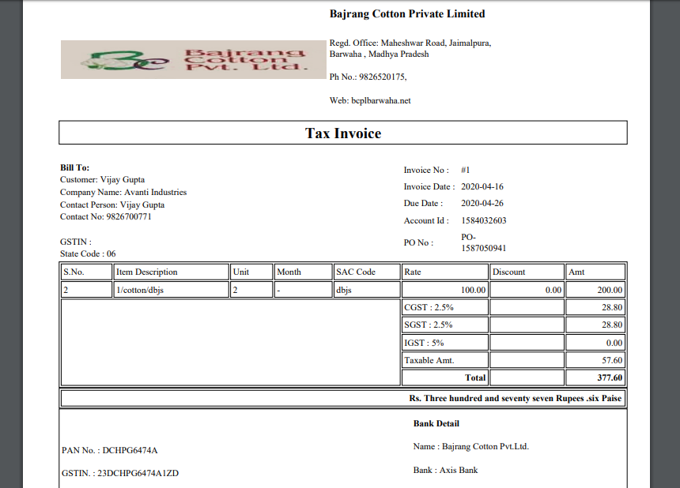
Bill Invoice

Slide 23
Thank You

